Slide 1
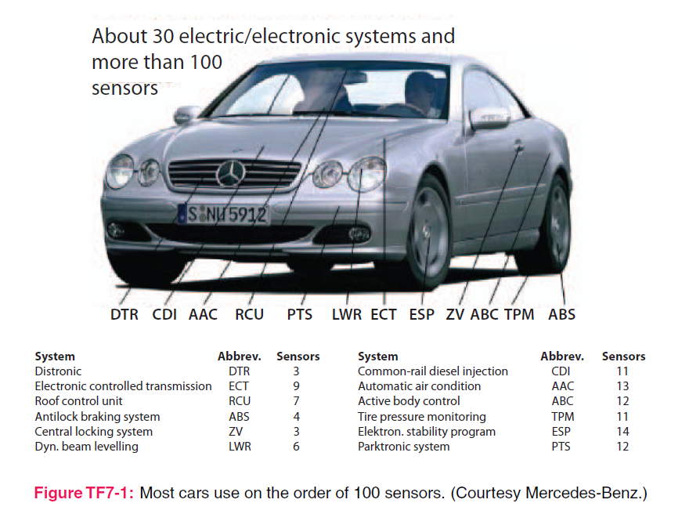
4. Electrostatics
Applied EM by Ulaby, Michielssen and Ravaioli

Slide 2
Chapter 4 Overview
Maxwell Equations
Charge and Current
Coulomb's Law
Gauss’s Law
Electrical Potential (Voltage)
Conductivity and Resistance
Boundary Conditions
Capacitance
Electrical Potential Energy
Image Method
Applications

Slide 3
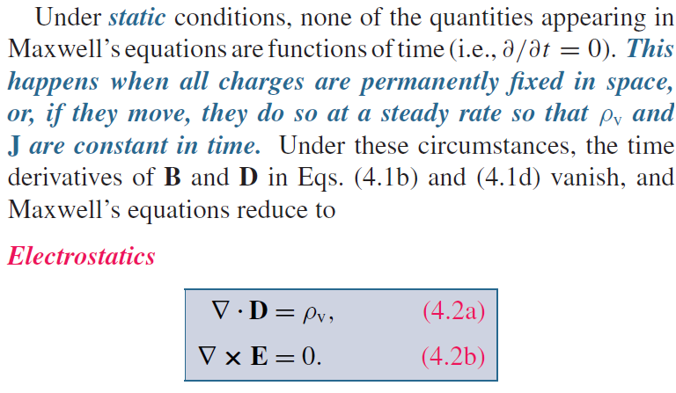
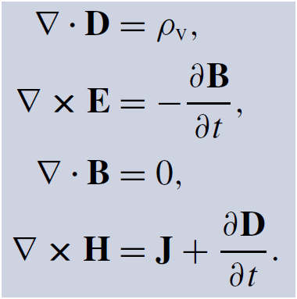
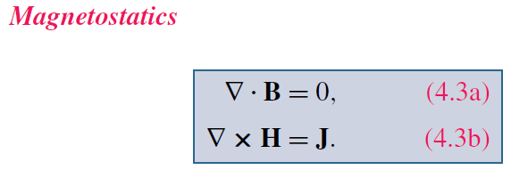
Maxwell’s Equations
God said:
And there was light!

Slide 4
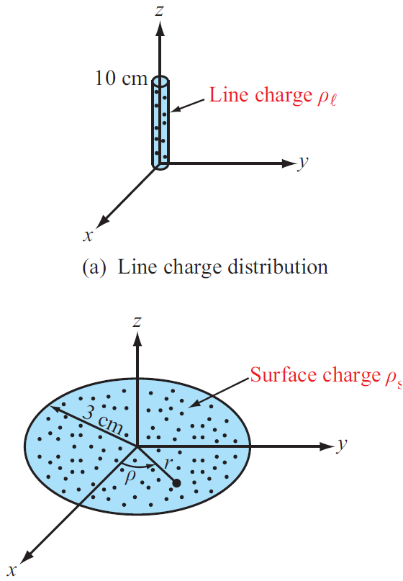
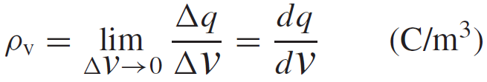
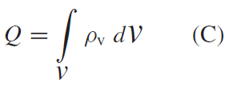
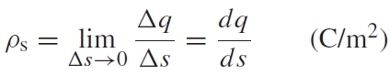
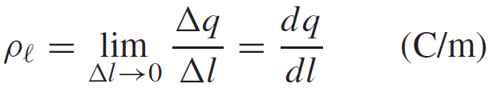
Charge Distributions
Volume charge density:
Total Charge in a Volume
Surface and Line Charge Densities

Slide 5
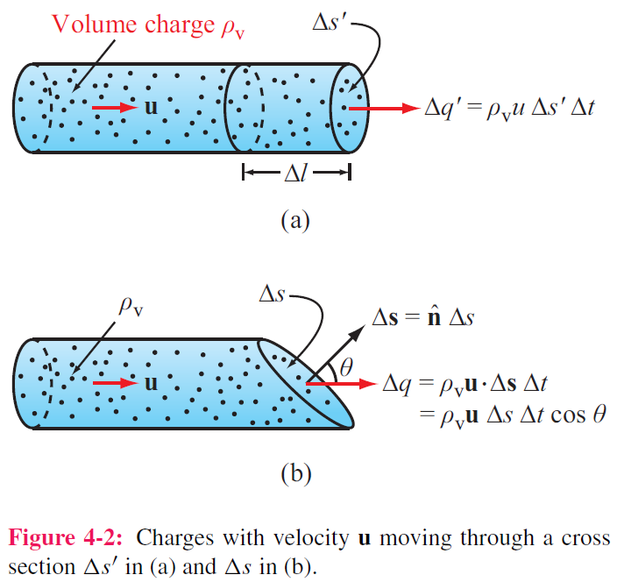
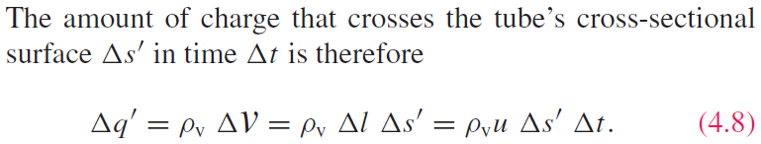
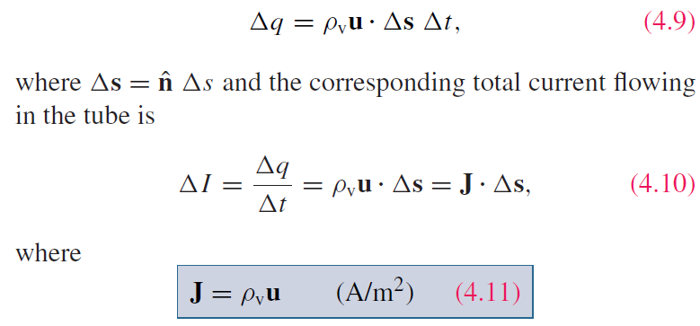
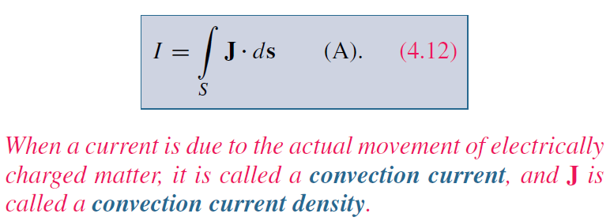
Current Density
For a surface with any orientation:
J is called the current density

Slide 6
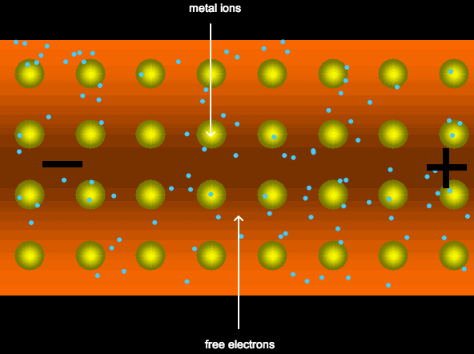
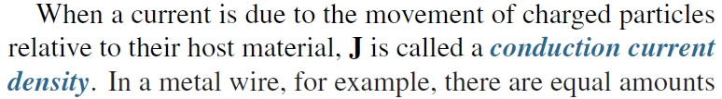

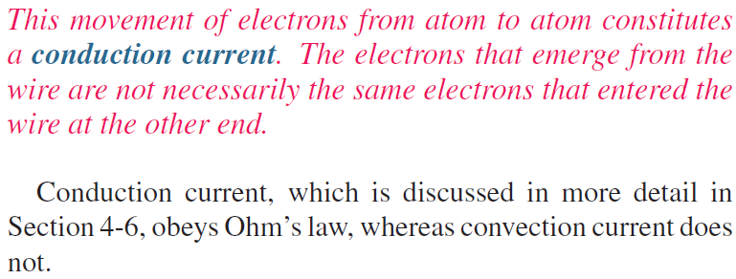
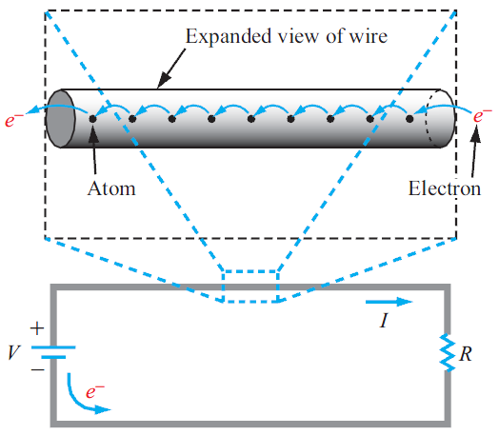
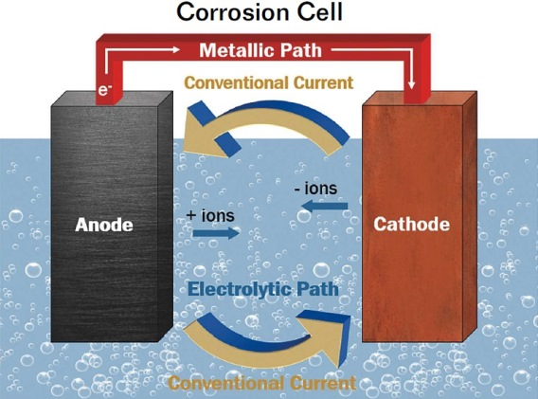
Convection vs. Conduction

Slide 7
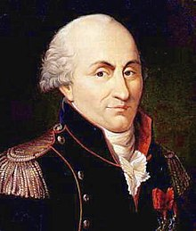
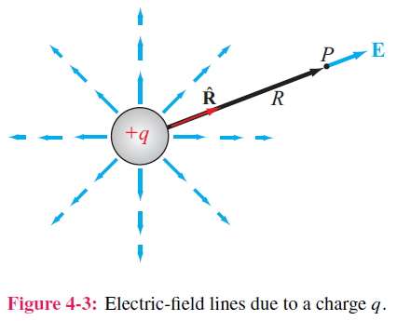
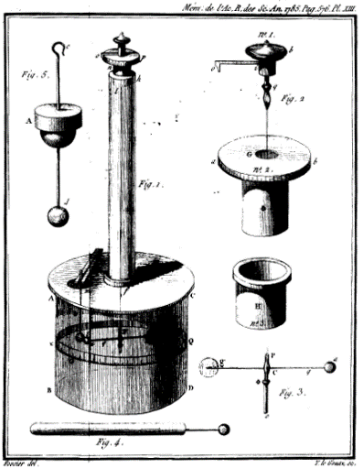
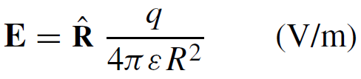
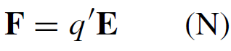
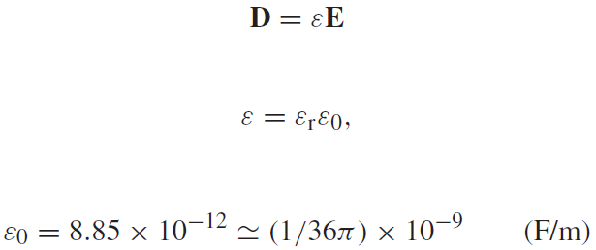
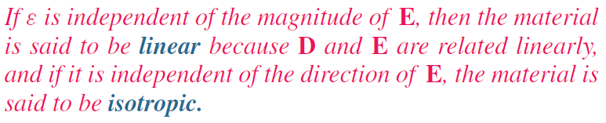
Coulomb’s Law
Electric field at point P due to single charge
Electric force on a test charge placed at P
Electric flux density D

Slide 8
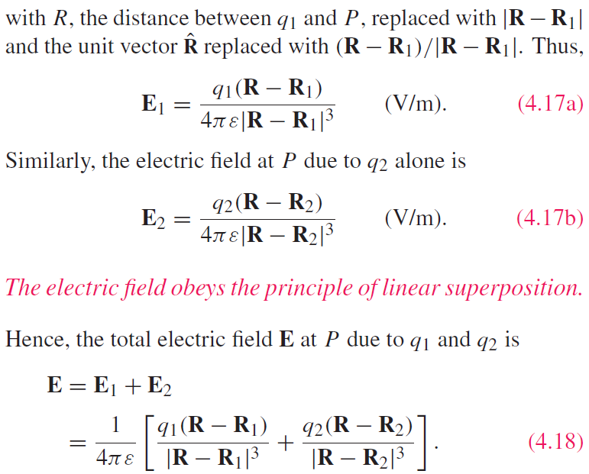
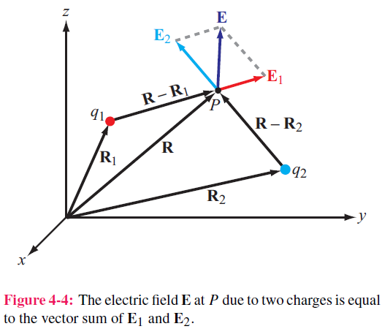
Electric Field Due to 2 Charges

Slide 9
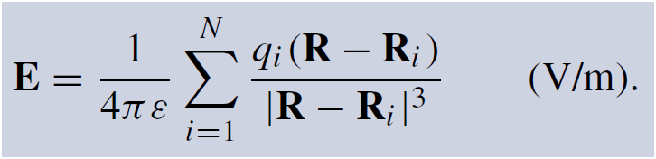
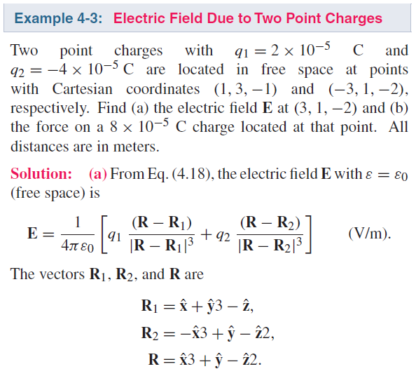
Electric Field due to Multiple Charges

Slide 10
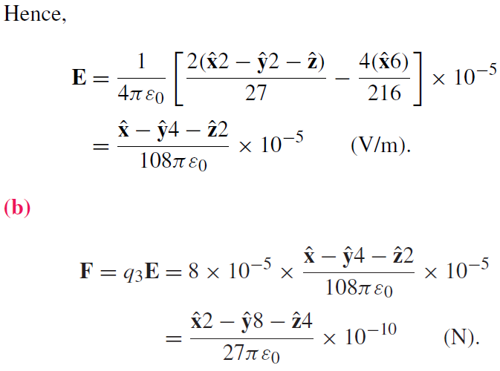
Electric Field due to Multiple Charges

Slide 11
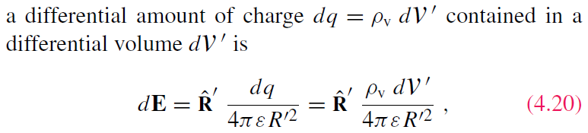
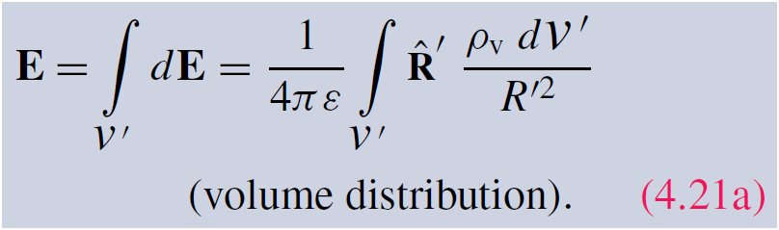
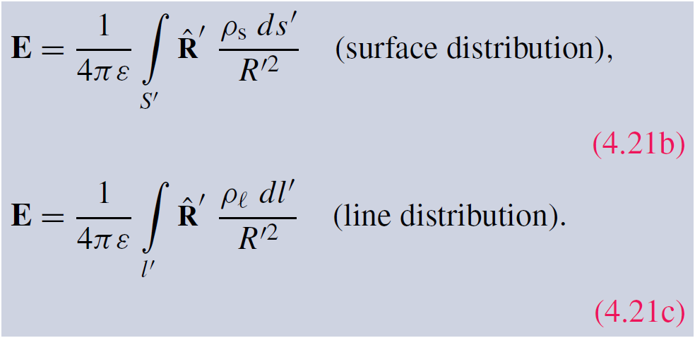
Electric Field Due to Charge Distributions
Field due to:

Slide 12
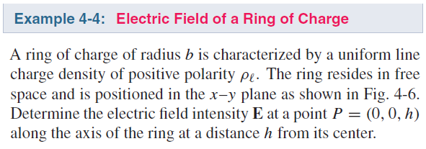
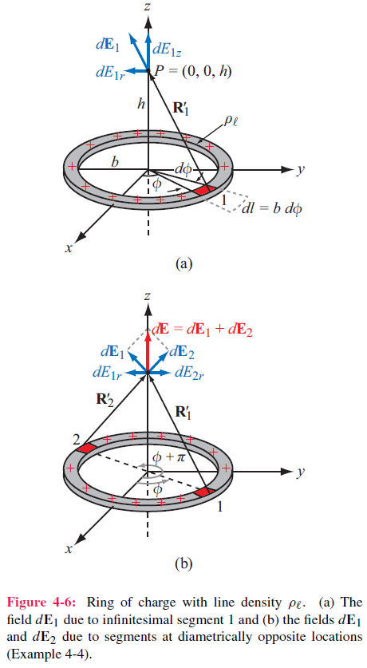
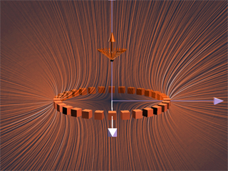
Cont.

Slide 13
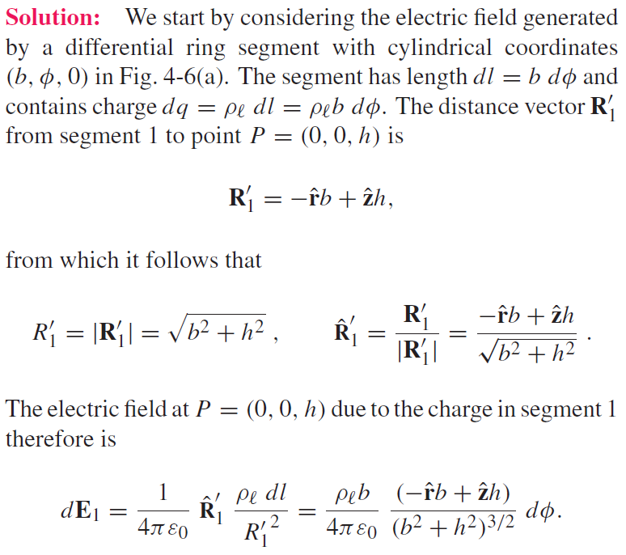
Cont.

Slide 14
Cont.

Slide 15
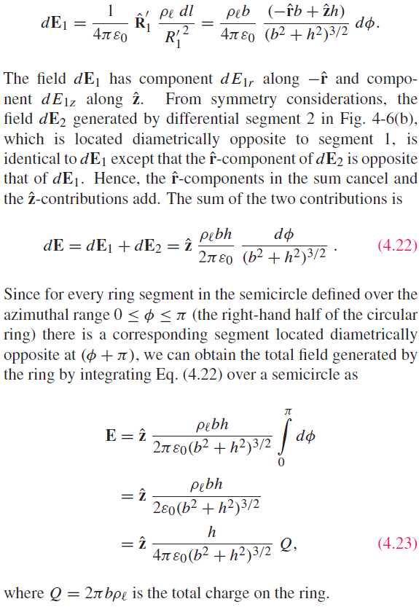

Slide 17
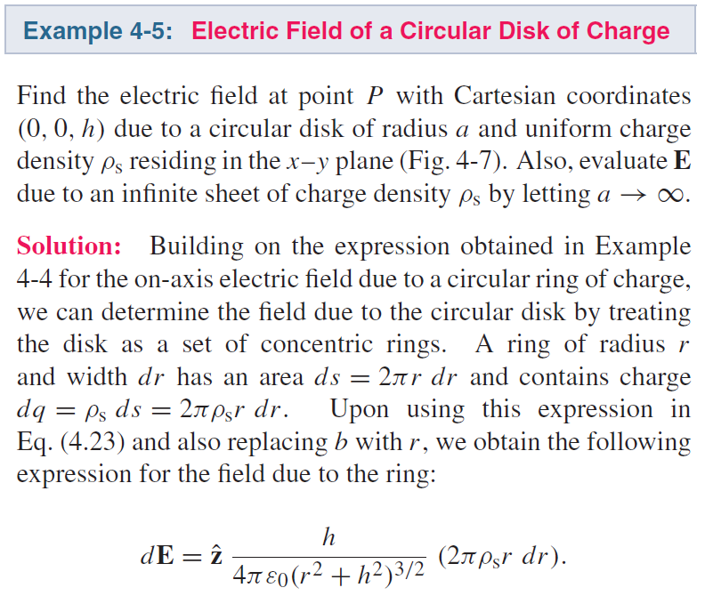
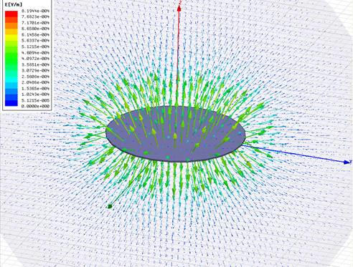
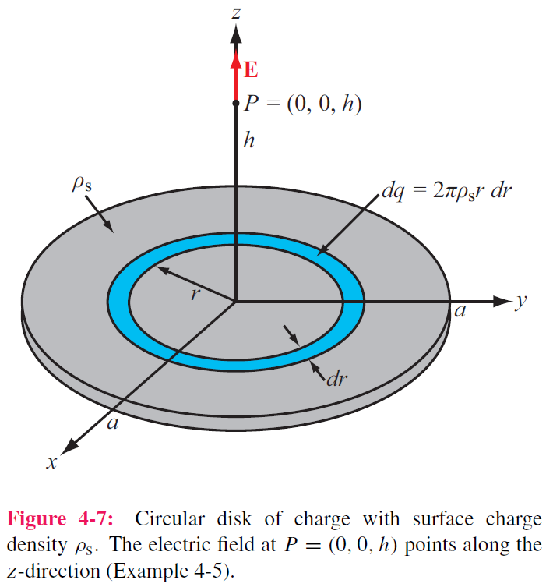
Cont.

Slide 18
Cont.

Slide 19
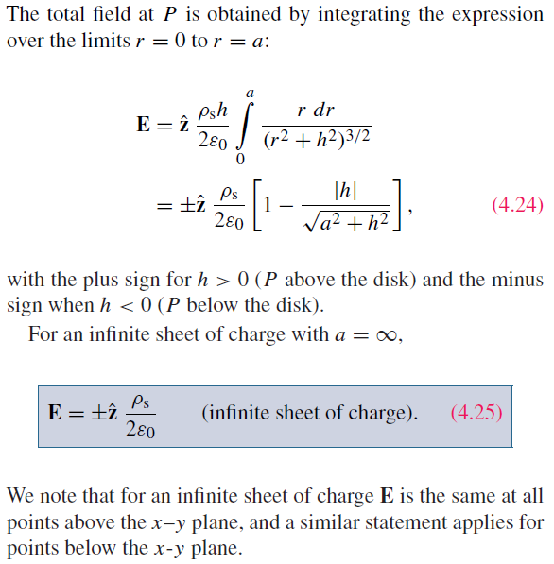
Example 4-5 cont.

Slide 20
Example 4-5 cont.

Slide 21
Example 4-5 cont.

Slide 22
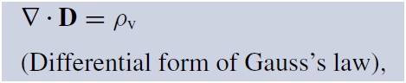
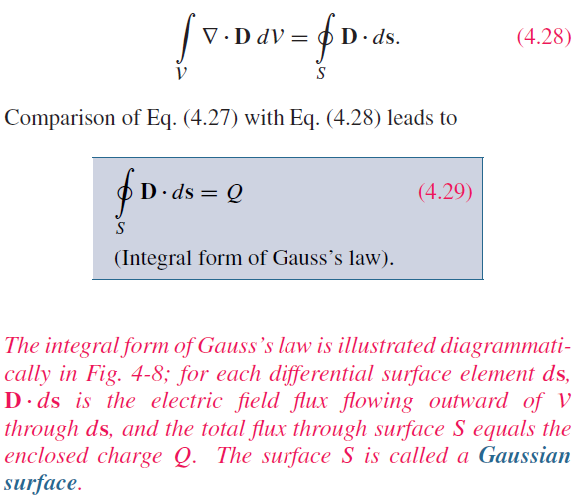
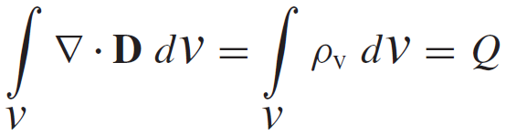
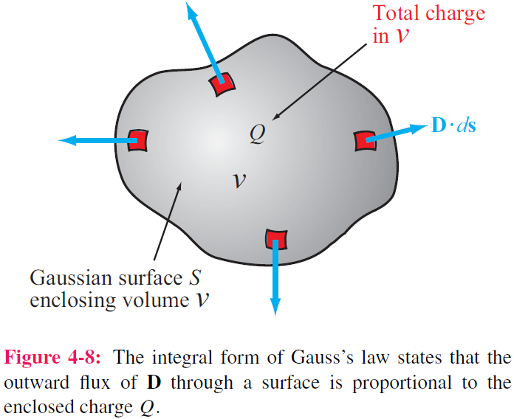
Gauss’s Law
Application of the divergence theorem gives:
A website to visualize E fields
https://www.falstad.com/vector3de/

Slide 23
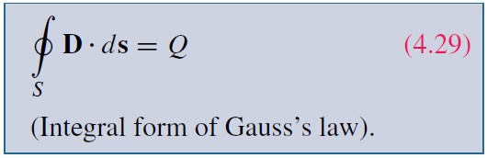
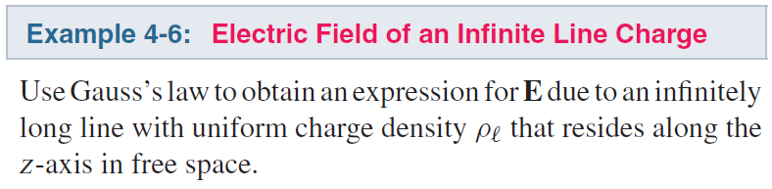
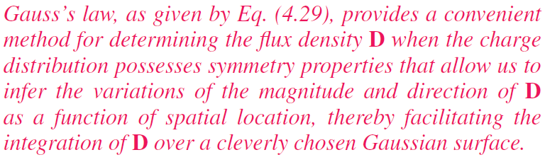
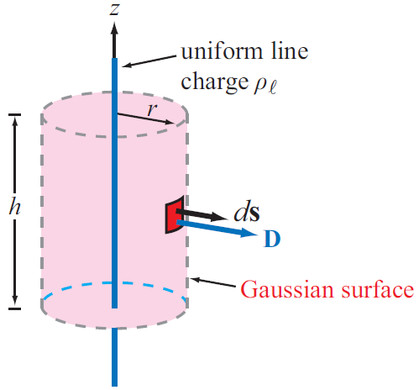

Applying Gauss’s Law

Slide 24

Applying Gauss’s Law
Construct an imaginary Gaussian cylinder of radius r and height h:

Slide 25
Applying Gauss’s Law
(30 pts) Charge Q is uniformly distributed inside a sphere with a radius of a. A thin spherical shell with a radius of b is concentric with the aforementioned sphere. The total charge on the shell is –Q, which is also uniformly distributed. Assume the permittivity is ε₀ everywhere. Find the E in all regions:
R≤a;
a≤R≤b;
R≥b.

Slide 26



Electric Scalar Potential
Minimum force needed to move charge against E field:

Slide 27



Electric Scalar Potential

Slide 28




Electric Potential Due to Charges
For a point charge, V at range R is:
In electric circuits, we usually select a convenient node that we call ground and assign it zero reference voltage. In free space and material media, we choose infinity as reference with V = 0. Hence, at a point P
For continuous charge distributions:

Slide 29

Relating E to V

Slide 30


Cont.

Slide 31



(cont.)

Slide 32


Poisson’s & Laplace’s Equations
In the absence of charges:

Slide 33




Conduction Current
Conduction current density:
Note how wide the range is, over 24 orders of magnitude

Slide 34

Conductivity
ρ_{ve} = volume charge density of electrons
ρ_{he} = volume charge density of holes
μ_{e} = electron mobility
μ_{h} = hole mobility
N_{e} = number of electrons per unit volume
N_{h} = number of holes per unit volume

Slide 35



Resistance
Longitudinal Resistor
For any conductor:

Slide 36



Slide 37

G’=0 if the insulating material is air or a perfect dielectric with zero conductivity.

Slide 38


Dielectric Materials

Slide 39


Polarization Field
P = electric flux density induced by E

Slide 40

Electric Breakdown
Electric Breakdown

Slide 41





Boundary Conditions

Slide 42
Boundary Conditions

Slide 43
Boundary Conditions

Slide 44

Summary of Boundary Conditions
Remember E = 0 in a good conductor

Slide 45

Conductors
Net electric field inside a conductor is zero

Slide 46

Field Lines at Conductor Boundary
At conductor boundary, E field direction is always perpendicular to conductor surface

Slide 47



Capacitance

Slide 48


Capacitance
For any two-conductor configuration:
For any resistor:

Slide 49




Slide 50



Slide 51

Application of Gauss’s law gives:
Q is total charge on inside of outer cylinder, and –Q is on outside surface of inner cylinder

Slide 52



Electrostatic Potential Energy
Electrostatic potential energy density (Joules/volume)
Energy stored in a capacitor
Total electrostatic energy stored in a volume

Slide 53



Image Method
Image method simplifies calculation for E and V due to charges near conducting planes.
For each charge Q, add an image charge –Q
Remove conducting plane
Calculate field due to all charges

Slide 54



Slide 56


Slide 57


Slide 58


[Newest 2020] Five Star Yagi Satellite HD TV Antenna up to 200 Mile Range, Attic or Roof Mount TV Antenna, Long Range Digital OTA Antenna for 4K 1080P... $56
Amazon Basics HDTV Digital Outdoor TV Antenna with Mounting Pole $39

Slide 59
Formulas in Electrostatics
Constitutive Relation
Current and Ohm’s Law
Voltage and E Field
Coulomb's Law
Boundary Condition
Capacitance
Gauss’s Law
Electric Energy Density

